Slide 1
Informatics Tools for Biodiversity Data Conversion
Kittinan Ponkaew
VisLab, Osaka
7/31/2013

Slide 2
Week 5 Progress
Updated the new version of the database. However there is a problem with compatibility of the program with the older version.
Finished testing several versions of the data conversion and formats. Still waiting for the real data to test on.

Slide 3
Plans for Week 6
Retry converting Herps database. There was a problem with conversion process
Hopefully resolve the backward compatibility issue.
Work on Paleo data sets and test them.

Slide 4
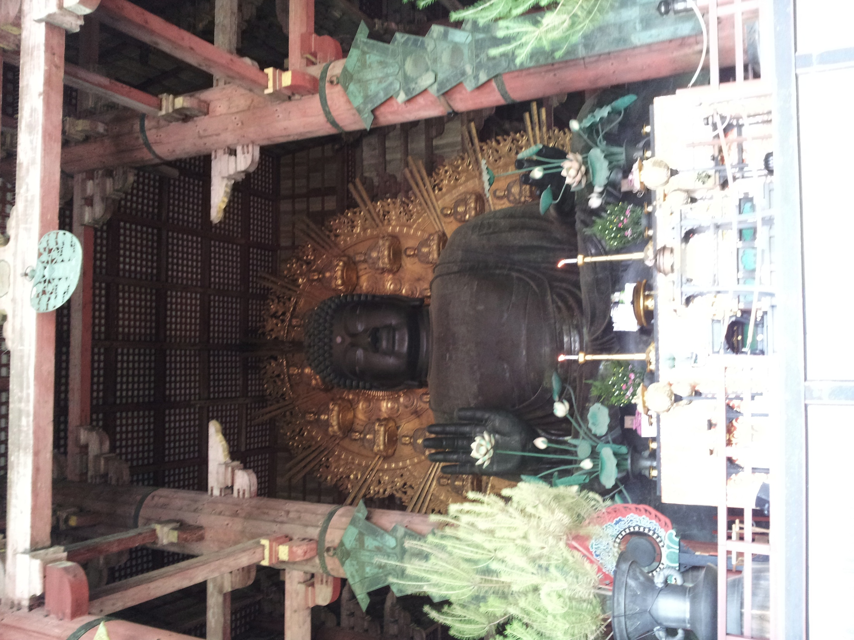
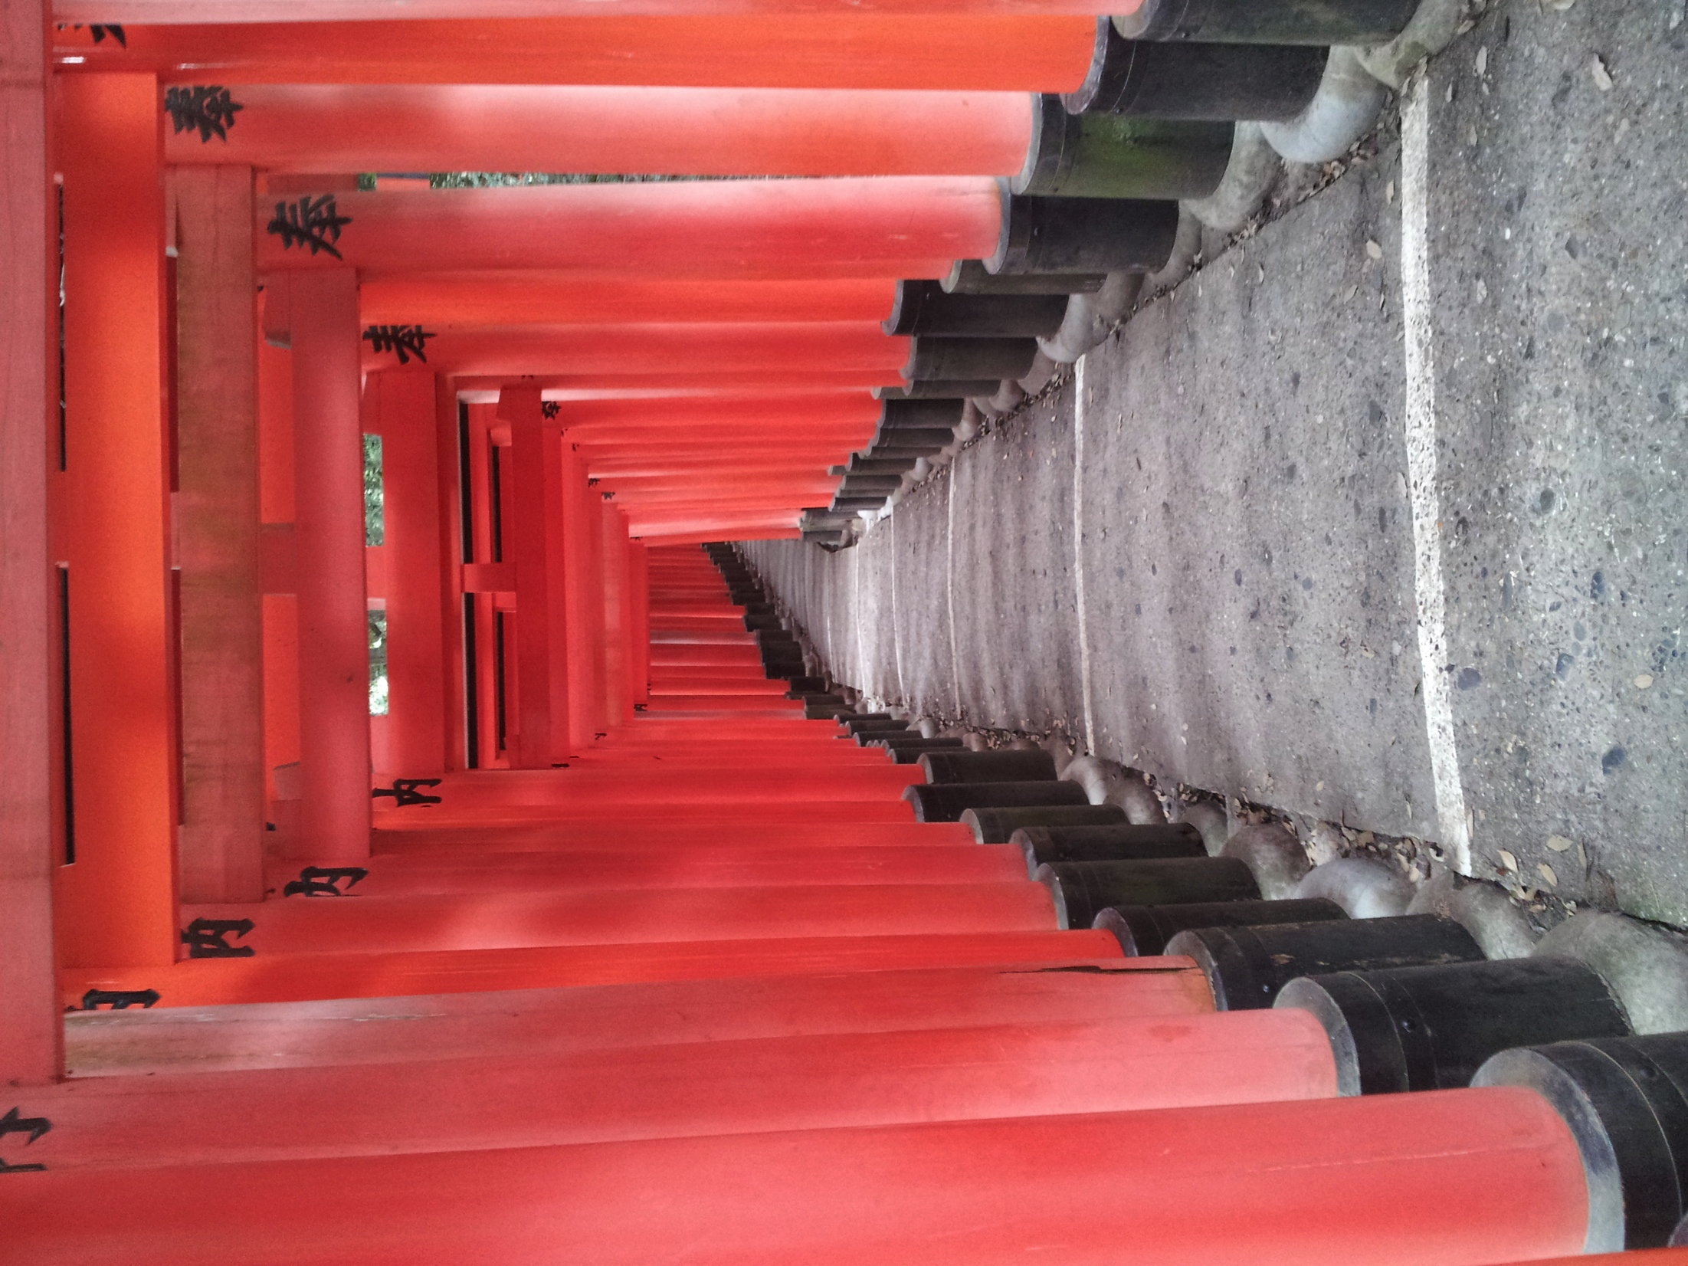
Cultural Exploration

Slide 5
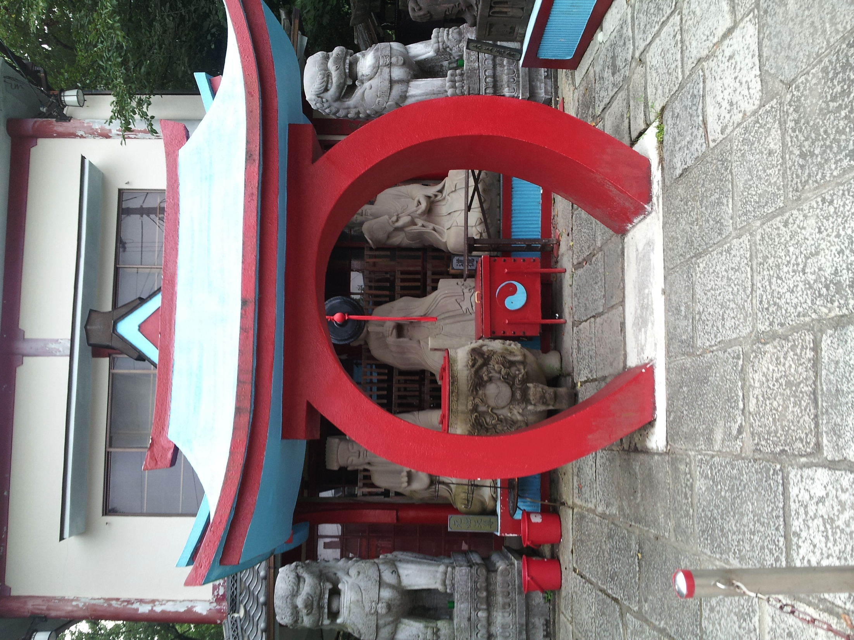
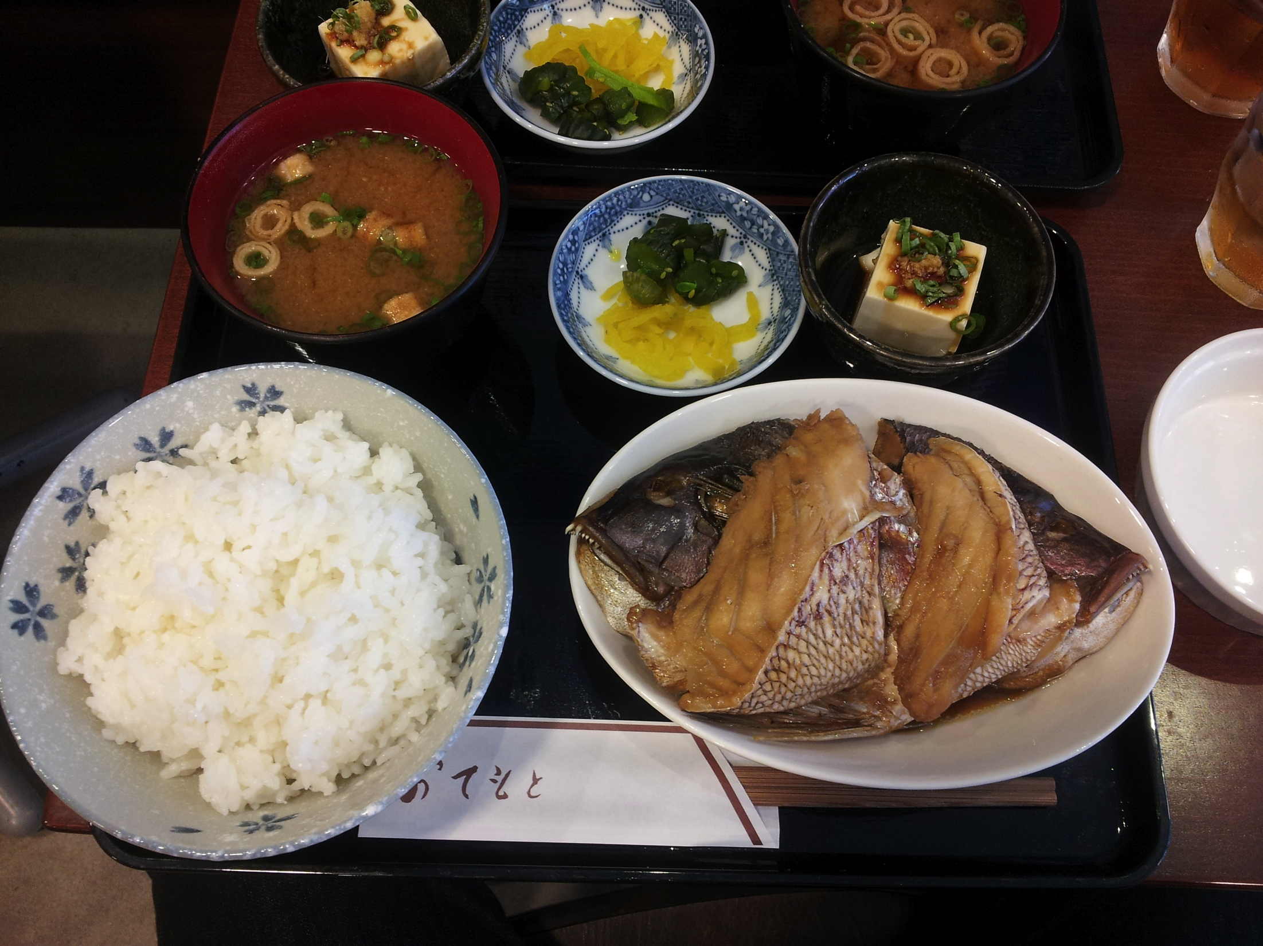
Cultural Exploration 2

Slide 6
Acknowledgement
Dr. Jason Haga
Dr. Shinji Shimojo
PRIME
NICT
Balboa Park Online Collaboration
PRIME alumna Haley Hunter-Zinck
NSF

